Slide 1
🌿 SMART AGRICULTURE • CONNECTED GREENHOUSE
AgroSense
Smart Greenhouse Monitoring System
Monitor • Manage • Grow
PROJECT GUIDE
TEAM • NO. 16
Dr. Karumuri Sri Rama Murthy
Asst. Professor
Department of CSE
KLU Hyderabad, Hyd
2520040048 VADDAVALLI SRI BHARGAVI NAGA SAI
2520040037 K. Joshita Sai
Department of Computer Science & Engineering | KLU Hyderabad
01

Slide 2
Abstract
A concise overview of the project
• AgroSense is a web-based prototype for greenhouse monitoring and environmental
• awareness. It presents soil moisture, temperature, humidity, and light intensity
• in one dashboard. The React interface displays readings clearly for
• convenient everyday greenhouse observation. JavaScript and CSS support interactive, readable
• visual presentation across the interface. Node.js and Express provide backend
• API endpoints for authentication and telemetry requests. PostgreSQL persistently stores
• user accounts and recorded sensor telemetry values. Passwords are hashed
• with bcrypt instead of being stored as plain text. The
• dashboard retrieves the latest saved reading and displays its recorded
• timestamp. Irrigation status is a demonstration control; no physical pump
100 WORDS
AGROSENSE • SMART GREENHOUSE MONITORING
02

Slide 3
Technologies Used
Three layers working together
01 FRONT-END
02 BACK-END / MIDDLEWARE
03 DATABASE
• React — component-based interface
• JavaScript / JSX — UI behaviour
• HTML — page structure
• CSS — layout and styling
• Vite — development server and build tool
• Node.js — JavaScript runtime
• Express.js — REST API routes
• CORS — frontend API access
• bcrypt — password hashing and verification
• dotenv — environment configuration
• pg — PostgreSQL connectivity
• PostgreSQL — relational data storage
• SQL — create, insert, and query records
• users — account details and password hashes
• sensor_readings — greenhouse telemetry
• pgAdmin — database inspection and management
AGROSENSE • SMART GREENHOUSE MONITORING
03

Slide 4
Problem Description
Why a unified monitoring interface is useful
THE CHALLENGE
THE AGROSENSE APPROACH
• Greenhouse conditions can change throughout the day.
• Checking multiple parameters manually takes time.
• Readings kept separately can be difficult to compare.
• Without stored records, reviewing earlier conditions is harder.
• Users need a simple view of key environmental values.
• One dashboard for moisture, temperature, humidity, and light.
• A backend API handles login and telemetry requests.
• PostgreSQL stores user accounts and readings.
• Latest saved values appear with a reading timestamp.
• A prototype foundation for future automation and alerts.
AGROSENSE • SMART GREENHOUSE MONITORING
04

Slide 5
System Architecture
Request and data flow
HTTP requests / JSON responses
USER
REACT FRONT-END
NODE + EXPRESS
POSTGRESQL
Signs in • views data
Dashboard • forms
REST API • validation
users • sensor_readings
FRONT-END
BACK-END
API EXAMPLES
DATA TABLES
localhost:5173
localhost:5000
POST /api/auth/login
GET /api/sensors
users
sensor_readings
The browser does not connect directly to PostgreSQL; the Express API mediates database access.
AGROSENSE • SMART GREENHOUSE MONITORING
05

Slide 6
Implementation Details
Key modules and what they do
1 USER AUTHENTICATION
Express routes handle registration and login; bcrypt hashes passwords and verifies login attempts.
2 SENSOR API
POST /api/sensors validates and stores a reading; GET /api/sensors returns the latest saved reading.
3 DATABASE LAYER
The pg package connects Node.js to PostgreSQL; parameterised SQL helps reduce SQL-injection risk.
4 DASHBOARD UI
React displays metric cards, demo irrigation status, recent sensor values, and the database timestamp.
5 PROJECT CONFIGURATION
server.js defines routes; db.js creates the database pool; .env stores local configuration; App.jsx renders the UI.
Scope note: irrigation is a demo status only; no physical sensors or pump are connected.
AGROSENSE • SMART GREENHOUSE MONITORING
06

Slide 7
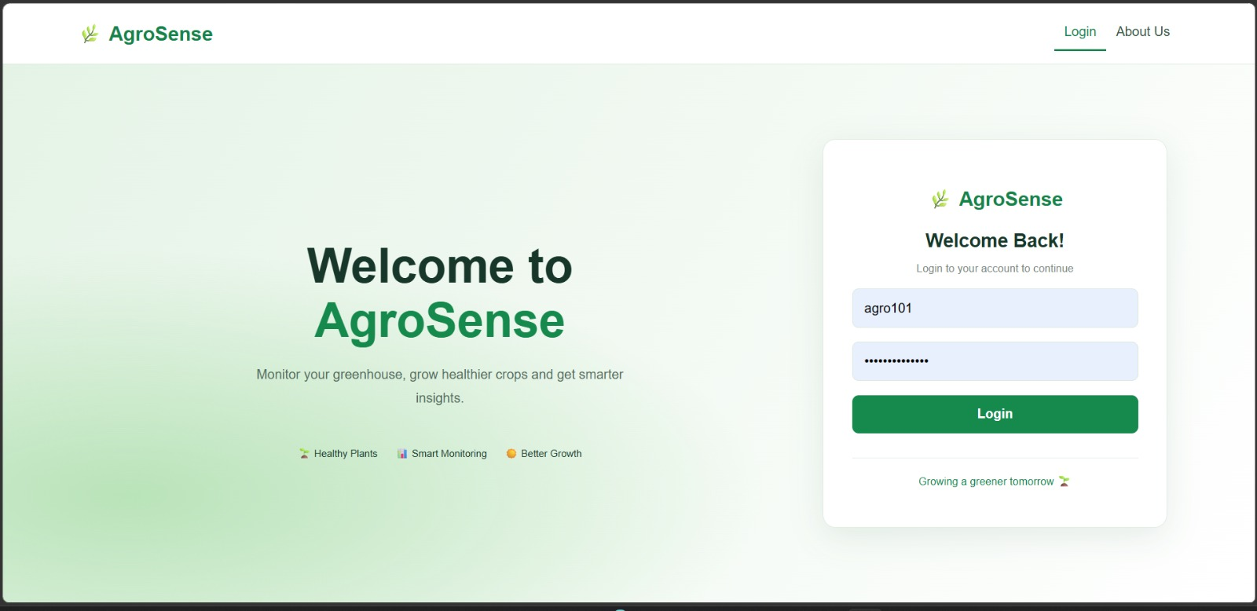
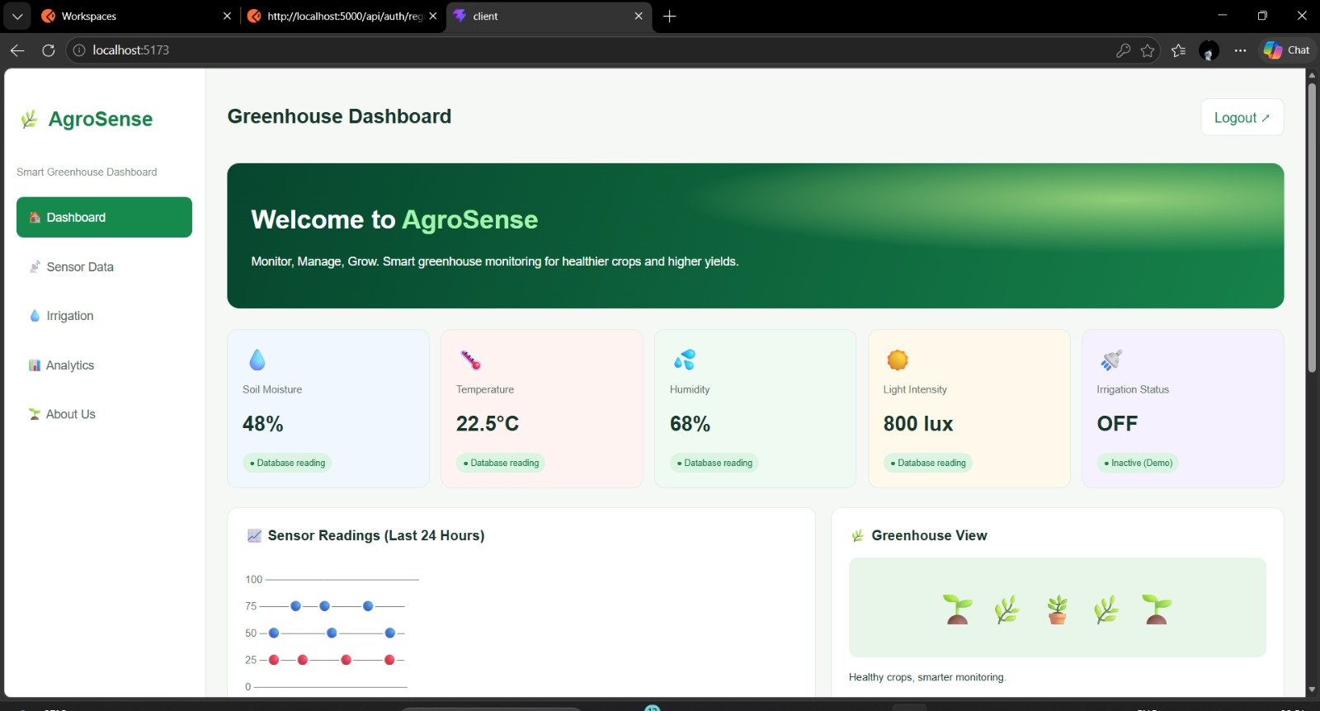
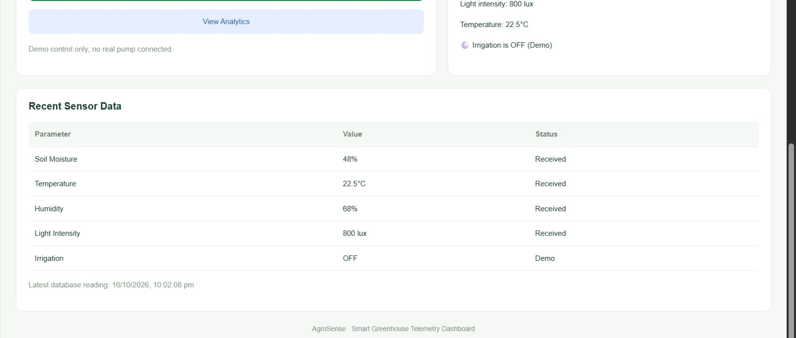
Output Screens
Screenshots from the AgroSense prototype
Login screen
Dashboard: metric cards, chart, and greenhouse view
Recent sensor data and database timestamp
AGROSENSE • SMART GREENHOUSE MONITORING
07

Slide 8
Future Enhancements
Path from prototype to connected greenhouse
01
Physical sensor integration
02
Live monitoring
Connect soil-moisture, temperature, humidity, and light sensors through a microcontroller.
Use periodic refresh or WebSockets to stream readings to the dashboard.
03
Smart irrigation
04
Alerts and recommendations
Add safe pump/valve control, moisture thresholds, manual override, and fail-safes.
Notify users when readings exceed configured ranges and suggest actions.
05
Historical analytics
06
Deployment and security
Store time-series readings and show trends, comparisons, and downloadable reports.
Use HTTPS, stronger session/token handling, role-based access, and hosted infrastructure.
Goal: evolve AgroSense into a reliable, sensor-connected greenhouse decision-support system.
AGROSENSE • SMART GREENHOUSE MONITORING
08

